Slide 1

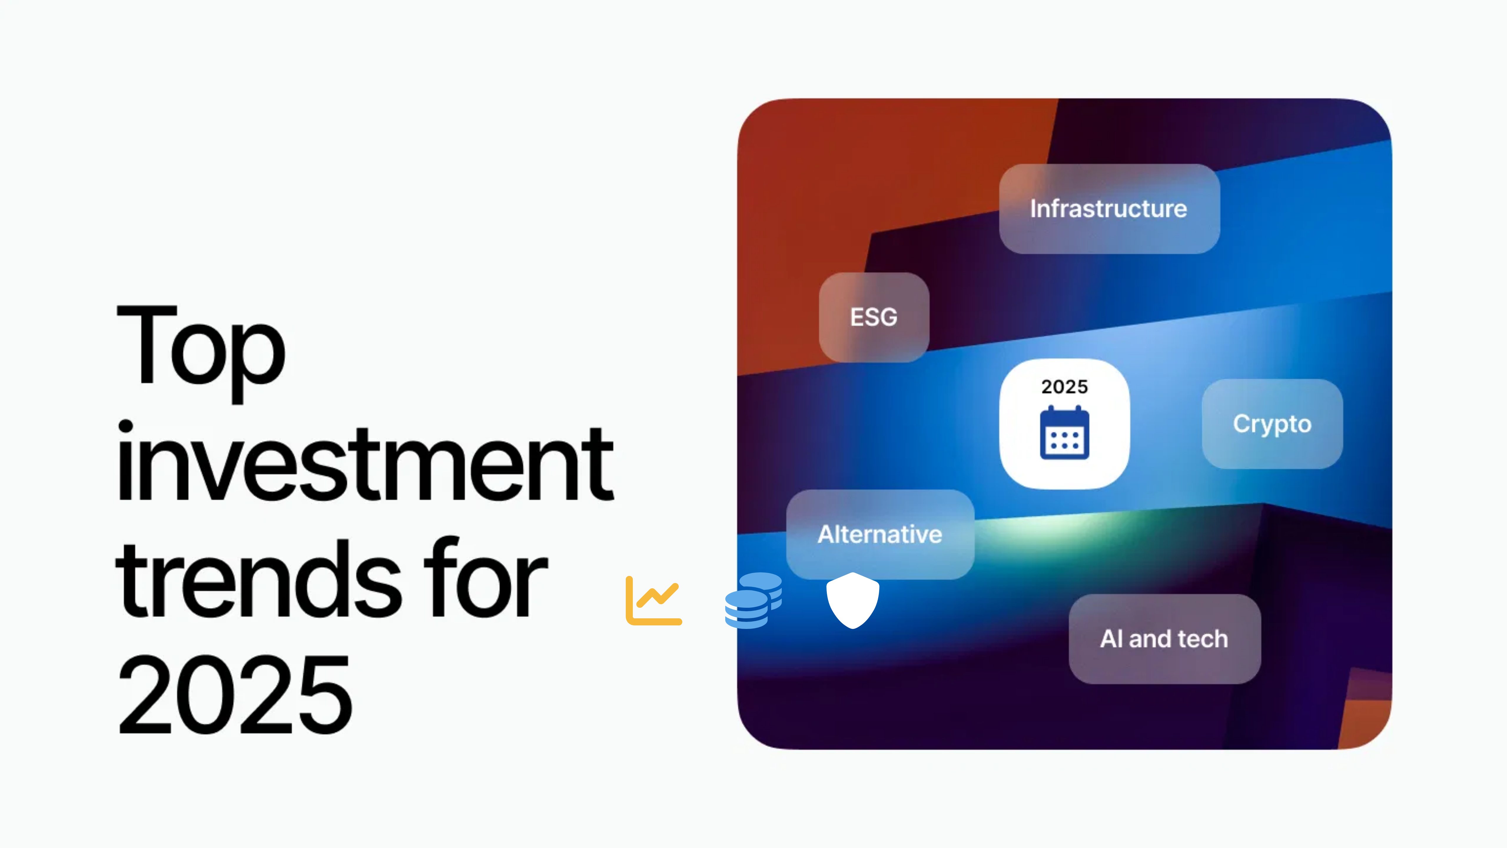



Investment in 2025
What to Choose, Trends, and Risks
June 2025

Slide 2







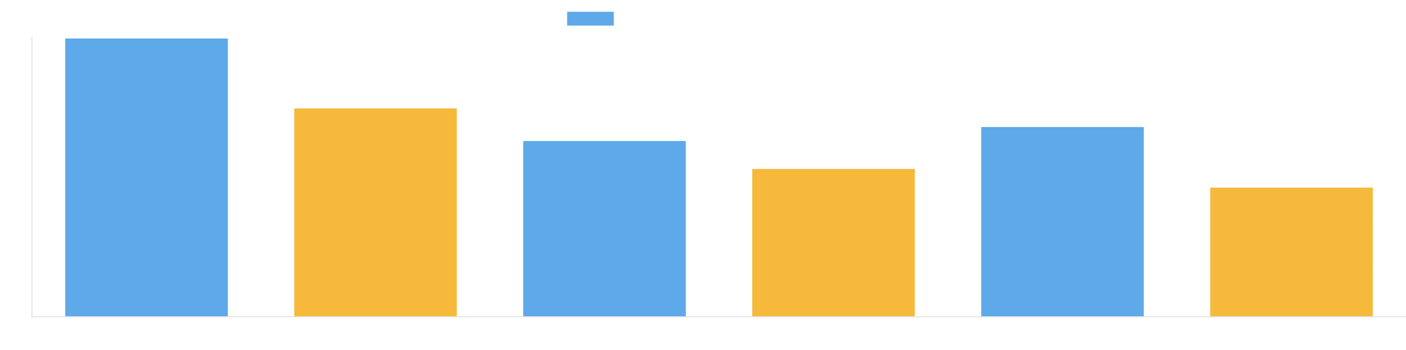
Key Investment Trends in 2025
Quantum Investment Boom
Energy Transition
60% increase in quantum startup funding compared to 2024
Long-duration energy storage solutions gaining traction
Deglobalization
Longevity Investments
Reshoring and near-shoring driving new investment opportunities
Healthcare innovation focused on extending healthy lifespan
Edge-AI IoT Growth
AI Evolution
Micro-data-centers and edge computing infrastructure expansion
Focus shifting to AI integration and specialized applications
Investment in 2025: What to Choose, Trends, and Risks

Slide 3





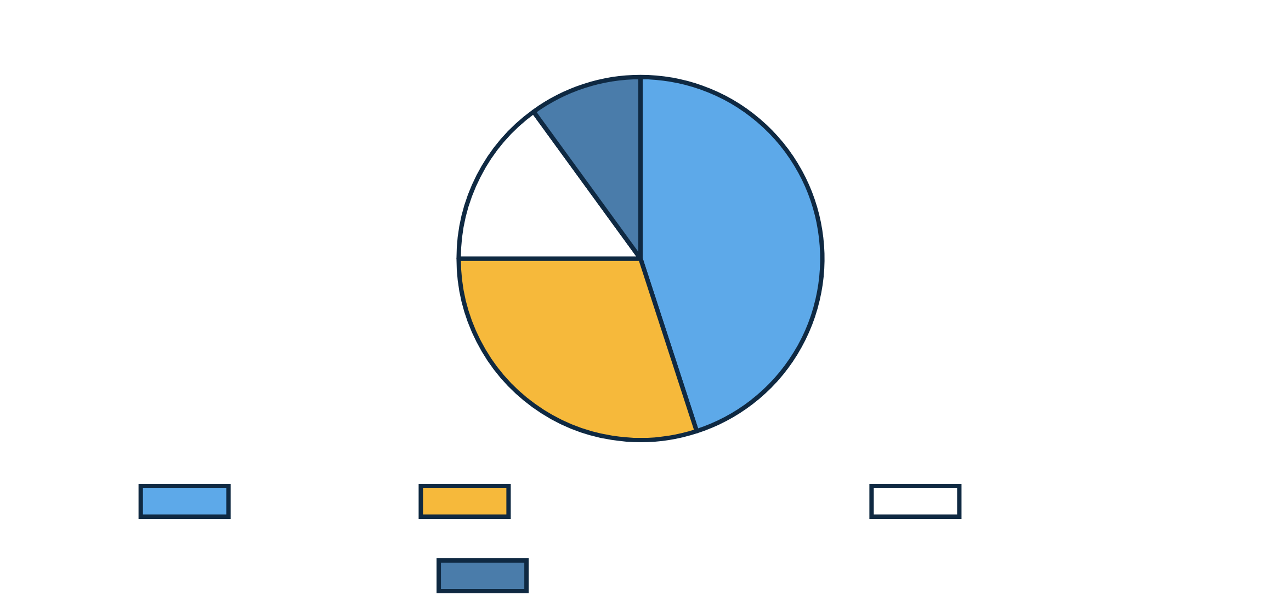
The 2025 Quantum Investment Boom
Q1 2025 Funding Highlights
Driving Factors
60%
increase in global quantum startup funding compared to Q1 2024
Technological Advancements:
Improved qubit stability and error correction
Several high-profile funding rounds closed, highlighting investor confidence
Market Demand:
Growing interest from finance, healthcare, and materials science
Focus on near-term quantum solutions with competitive edge in specific industries
Government Support:
Public-private partnerships accelerating innovation
Talent Growth:
Increasing availability of quantum scientists and engineers
Key Investment Areas
Hardware:
Superconducting qubits, trapped ions, photonic quantum computers
Software:
Quantum algorithms and development tools
Applications:
Finance, healthcare, materials science
Investment in 2025: What to Choose, Trends, and Risks

Slide 4

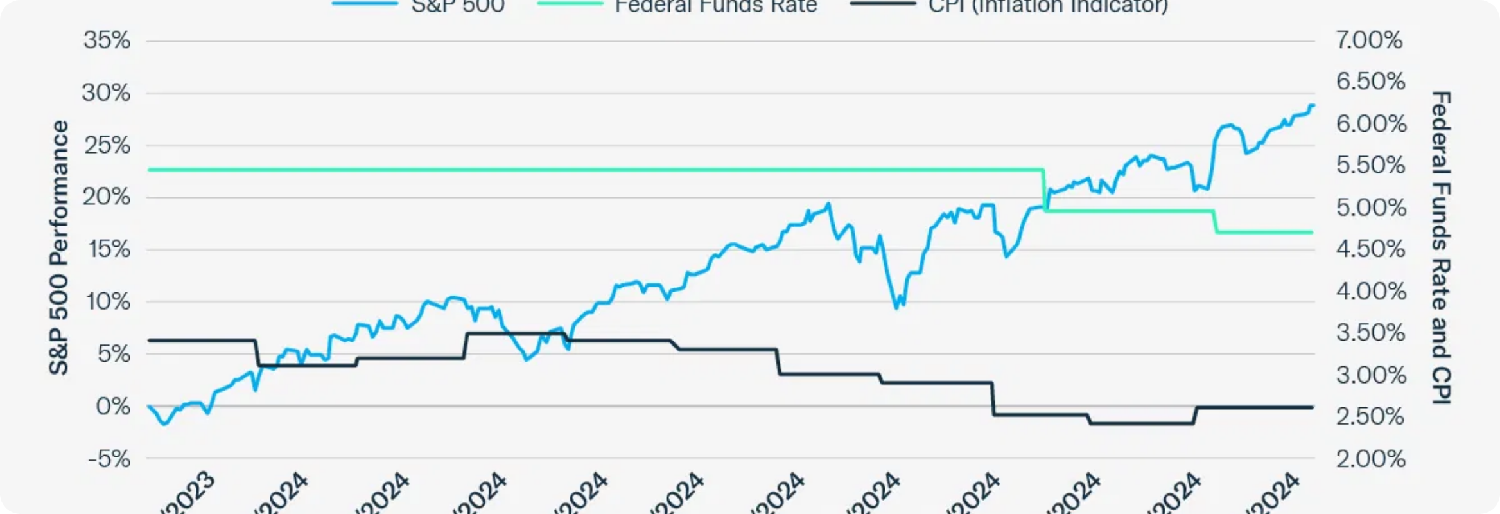


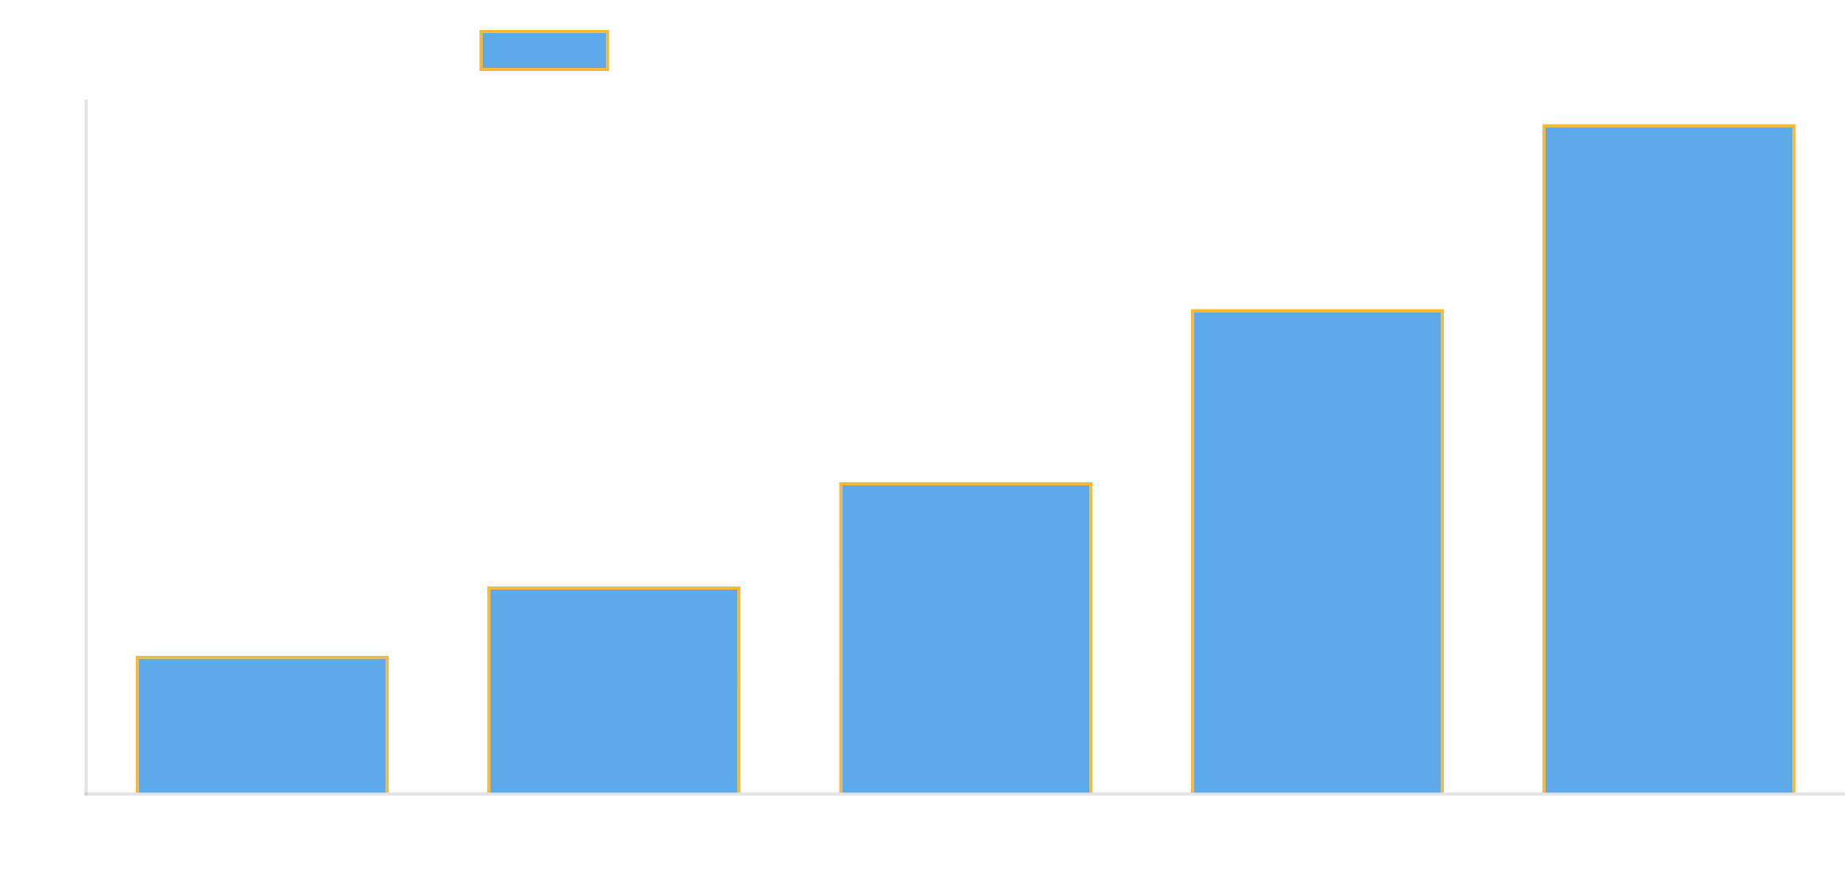
Energy Storage: A Growing Investment Opportunity
Promising Storage Technologies
Advanced Lithium-ion
Improved energy density and longer cycle life for grid-scale applications
Flow Batteries
Market Growth Drivers
Vanadium and zinc-based solutions for long-duration storage needs
Increasing penetration of renewable energy sources requiring storage solutions
Gravity-Based Storage
Mechanical systems using gravity for efficient energy storage
Grid stability concerns driving demand for long-duration storage
Government incentives and policy support for clean energy infrastructure
Green Hydrogen
Hydrogen production and storage for seasonal energy needs
Declining costs making energy storage more economically viable
Investment in 2025: What to Choose, Trends, and Risks

Slide 5





What to Choose: Promising Investment Areas
Quantum Computing
Energy Storage
AI Applications
Focus on companies developing quantum hardware, software platforms, and specialized applications in finance and drug discovery.
Invest in advanced battery technologies, flow battery startups, and grid-scale storage solution providers.
Target specialized AI solutions in healthcare diagnostics, financial services, and industrial automation.
Potential Return:
High
Potential Return:
Medium-High
Potential Return:
Medium-High
Healthcare & Longevity
Edge-AI IoT
Carbon Markets
Consider biotech firms focused on age-related diseases, precision medicine, and health monitoring technologies.
Look for companies building micro-data-centers, edge computing infrastructure, and IoT security solutions.
Explore carbon credit trading platforms, voluntary carbon market infrastructure, and carbon removal technologies.
Potential Return:
Medium
Potential Return:
Medium-High
Potential Return:
Medium
Investment in 2025: What to Choose, Trends, and Risks

Slide 6






Potential Risks to Consider
Economic Uncertainty
Market Concentration
Fluctuating interest rates, inflation, tariffs, and global instability creating market volatility.
High concentration in tech stocks, particularly AI, creating potential bubble risks.
Impact:
Impact:
Geopolitical Risks
Climate-Related Risks
Trade tensions, policy uncertainty, and regional conflicts affecting global markets.
Physical climate disruptions and transition risks affecting supply chains and infrastructure.
Impact:
Impact:
Investment in 2025: What to Choose, Trends, and Risks

Slide 7

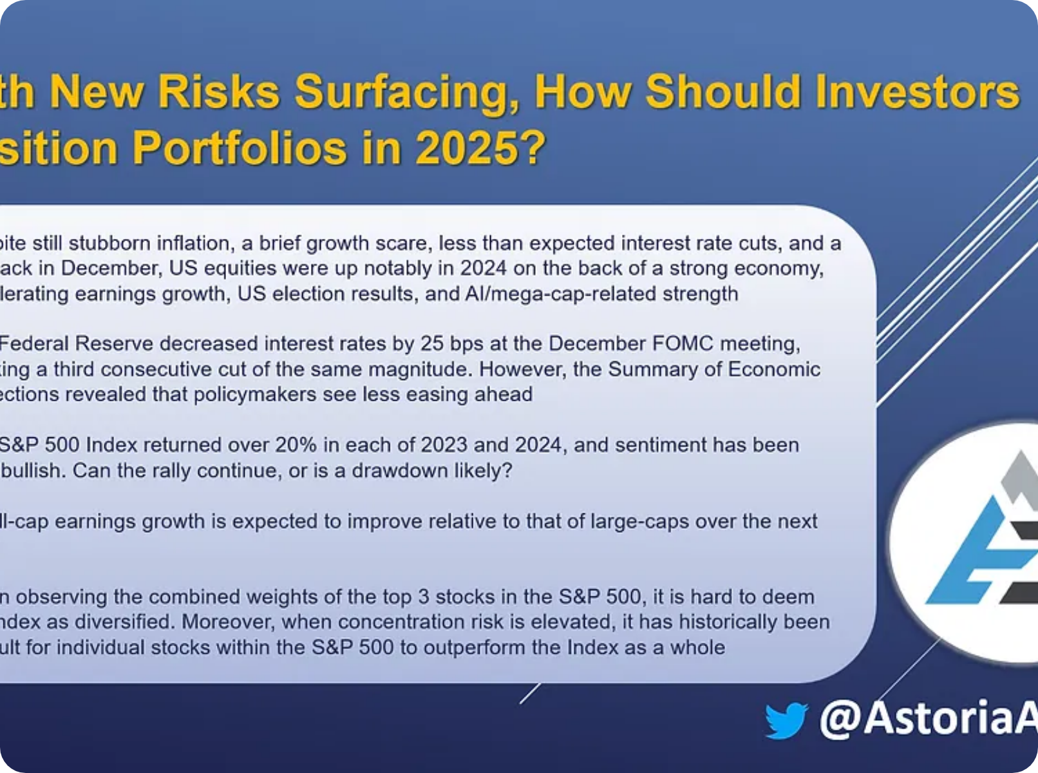





Risk Mitigation Strategies
Portfolio Diversification
Spread investments across different asset classes, sectors, and geographies to reduce exposure to any single risk factor.
Strategic Asset Allocation
Adjust portfolio weightings based on risk tolerance, time horizon, and changing market conditions.
Staying Informed
Continuously monitor market trends, economic indicators, and geopolitical developments to make timely adjustments.
Long-term Perspective
Maintain focus on long-term goals rather than reacting to short-term market fluctuations.
Recommended Asset Allocation for 2025
Investment in 2025: What to Choose, Trends, and Risks

Slide 8







Conclusion and Recommendations
Key Takeaways
Recommendations
2025 presents significant opportunities in quantum computing, energy storage, and AI applications.
Short-term:
Focus on energy storage and edge-AI IoT investments for immediate growth potential.
Technological advancements are accelerating across multiple sectors, creating new investment avenues.
Medium-term:
Gradually increase exposure to quantum computing and healthcare innovation.
Economic uncertainty and geopolitical risks remain the top concerns for investors.
Long-term:
Maintain a balanced portfolio with strategic allocations to emerging technologies.
Strategic diversification and informed decision-making are essential for navigating market volatility.
Risk management:
Implement regular portfolio reviews and stay informed about market developments.
The investment landscape of 2025 offers both
unprecedented opportunities
and
significant challenges
.
Success will depend on strategic foresight, adaptability, and a balanced approach to risk management.
info@babakhome.com
www.babakhome.com
+1 (555) 123-4567
Investment in 2025: What to Choose, Trends, and Risks

